Slide 1

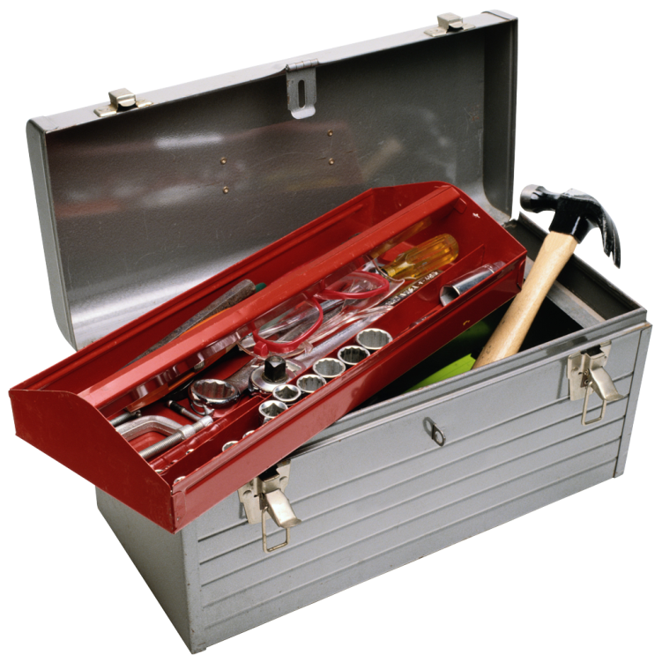

Sugerencias y recomendaciones para el sector en Colombia
Some preliminary comments on the approach and the methodology adopted:
Bottom up approach (from individual surveys to collective evaluation)
SWOT analysis as basic tool
General recommendations

Slide 2
Sugerencias y recomendaciones para el sector en Colombia
TARGET: increase the competitiveness of the Colombian shoe companies (of the target group) on the international markets and improve their export capabilities.
Points of STRENGHT useful to achieve the goal
RISKS on the way of the desired achievements
OPPORTUNITIES to take advantage of to reach the goals
WEAKNESESS that can jeopardize the achievement

Slide 3
Sugerencias y recomendaciones para el sector en Colombia
COMPANY | STREGHT | WEAKNESS | RISKS | OPPORTUNITIES
1 | Technology and production capacity | Lack of competitive products | Market shrinking export contraction | Flexibility in production, innovative materials , technical product
2 | Direct sale to captive clients | Obsolete products | Weakening competitiveness | New product developments, TPU/PU technology, flexibility
3 | Good organizational and productive structure; market position | High prices, lack of knowledge of international markets | Difficulty / impossibility to open new markets | Development of a “technical” products; new market openings
4 | Manufacturing specialization | High prices | Market shrinking | Flexibility; room for revision of material, components and costs
5 | Focus on high potential products (lady shoes) | High prices | Reduction in sale volumes | Development of new line of products ( ethnic)
6 | High production standards; good market positioning; market oriented | Obsolete production technologies; very traditional product | Difficulty / impossibility to open new markets | Room for improving production and product standards; flexibility in production ; technical product
7 | Good product collection and market position | High prices; insufficient production capacity | Difficulty / impossibility to open new markets | Upgrade of manufacturing facilities; material cost reduction; web strategy
8 | Product suited for export | Prices not really competitive | Contraction in sale volumes | Development of new line of products ( ethnic)
9 | Good production facilities; export vocation | Obsolete design department; no high technologies; insufficient production | Loss of global market | Development of trekking product; flexibility in production
10 | Integrated production | Anonymous product; non professional marketing; no product development | Loss in competitiveness; unattractive price / quality ratio | Growth in quality; price engineering; development of “personal” products

Slide 4

Sugerencias y recomendaciones para el sector en Colombia
Main common points of strength:
Production capacity / flexibility
Integrated / internalized manufacturing cycle
Export orientation (some)

Slide 5

Sugerencias y recomendaciones para el sector en Colombia
Main common weaknesses:
Manufacturing costs / selling prices
Obsolete products, uncompetitive, anonymous
Inadequate technologies

Slide 6

Sugerencias y recomendaciones para el sector en Colombia
Strategic action lines:
Technological upgrade
Improvement in product development ; technical standards
Improvement in product development ; creativity
Increase market knowledge (intelligence)

Slide 7

Sugerencias y recomendaciones para el sector en Colombia
Operative short term proposals:
Check up and upgrade of technological service centre
Check up and upgrade certification laboratory
Creation of a design / creative centre and school
Master courses in market development and internationalization

Slide 8
Sugerencias y recomendaciones para el sector en Colombia
SERGIO DULIO
PISIE Expert
in footwear technologies, applied research and company upgrade programs

